Slide 1
Chinese Restaurant Investment in Football-Popular European Cities

Slide 2
Introduction
A flavorful Chinese cuisine can be a great complement after watching an exciting live European football match in the stadium
Objective is to use data and K-mean clustering to classify 30 football-popular cities and determine which is favorable to make an investment decision to open a Chinese restaurant close to the local stadium
Target audience would be those who’re interested in investing in the project.

Slide 3
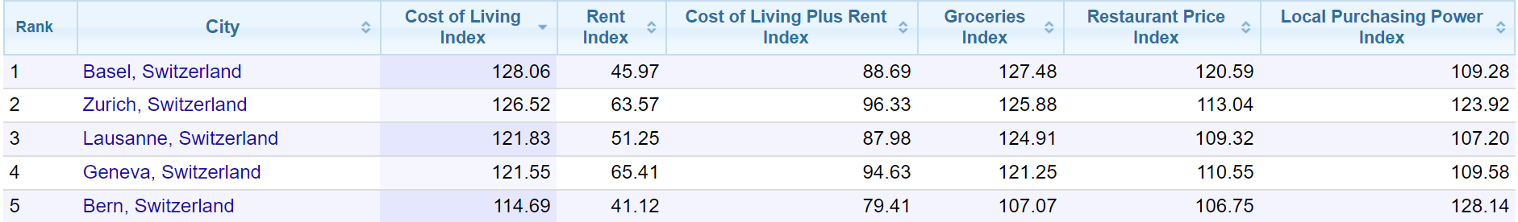
Data Descriptions
Population of the 30 cities will be used.
Milan, Munich, Hamburg, Berlin, Paris, Florence, London, Madrid, Amsterdam, Vienna, Saint Petersburg, Kyiv, Moscow, Turin, Rome, Naples, Leipzig, Toulouse, Liverpool, Manchester, Barcelona, Brussels, Athens, Seville, Porto, Lisbon, Prague, Warsaw, Zagreb, Zurich
Foursquare data will be used to explore the existing Chinese restaurants that are the closest to the local stadiums among the 30 cities.
Cost of living, safety index, salary, restaurant index data of the 30 cities from Numbeo are referenced

Slide 4
Methodology
The distance of the closest existing Chinese restaurant to the local stadium from Foursquare is used
The higher this attribute the more favorable to an investment decision
Population data and other data such as salary and cost of living from Numbeo are filtered down to the 30 cities of interest
All data are merged to create a dataframe of 30 rows and 20 columns
12 columns/attributes are analyzed using K-mean clustering method
Attributes for the classifications are: population, safety index, distance to the stadium of the closest Chinese restaurant, local purchasing power index, gross rental yield city center, gross rental yield outside of center, 1/net salary, 1/rent index, 1/cost of living index, 1/groceries index, 1/restaurant price index, 1/crime index.
Some attributes are reciprocals so all attributes will be clustered in proximity to desire
All attributes are normalized using preprocessing package from sklearn so every attribute weighs the same

Slide 5
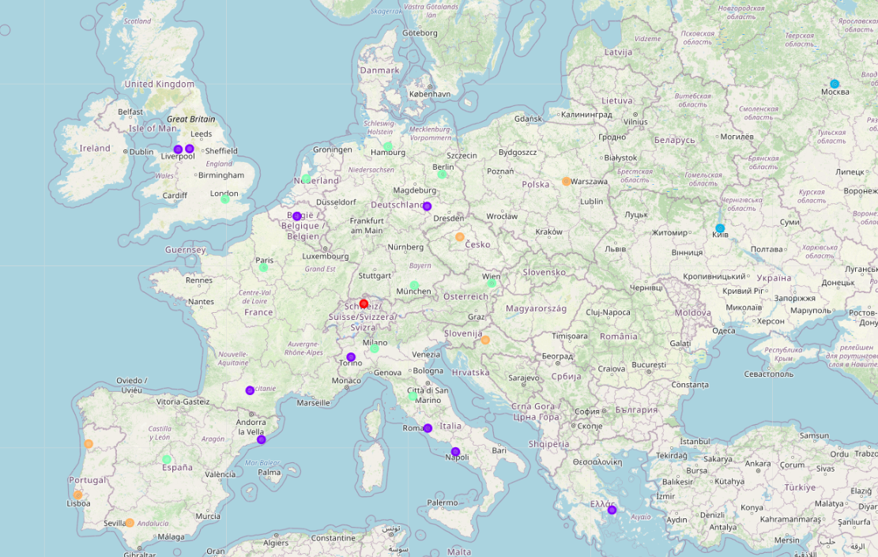
Results - Map with 30 Cities Classified
Class 0
Class 1
Class 2
Class 3
Class 4

Slide 6
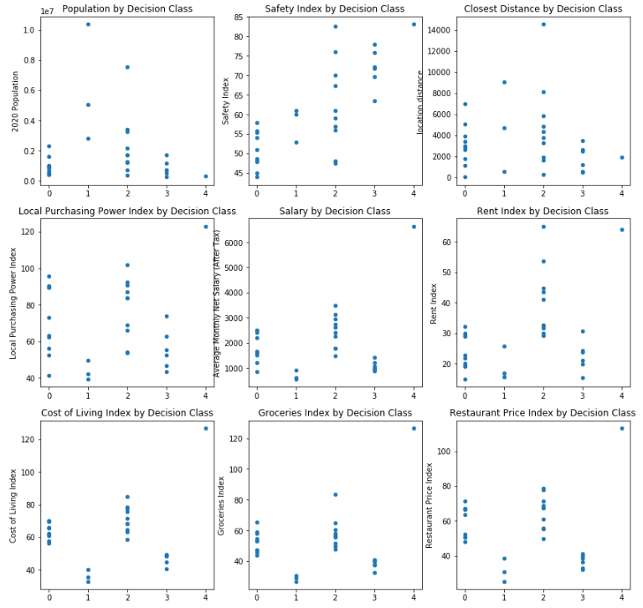
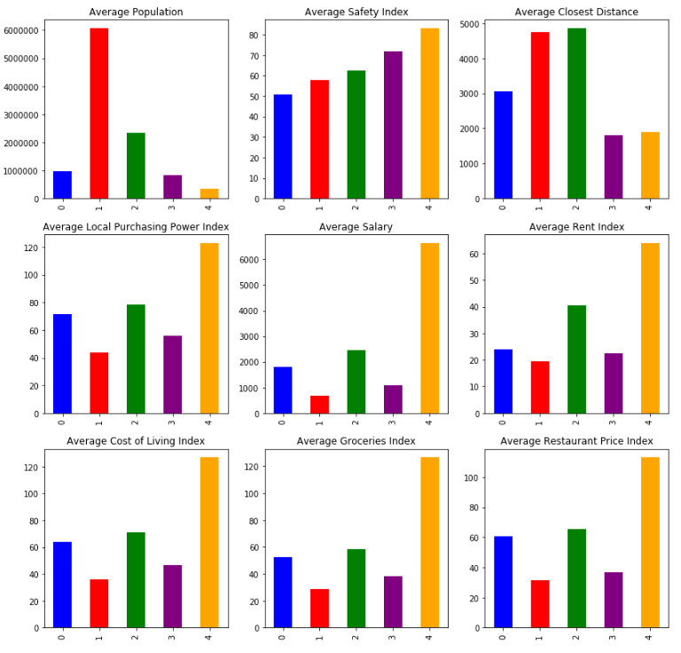
Results – Analysis of 9 Attributes by Class

Slide 7
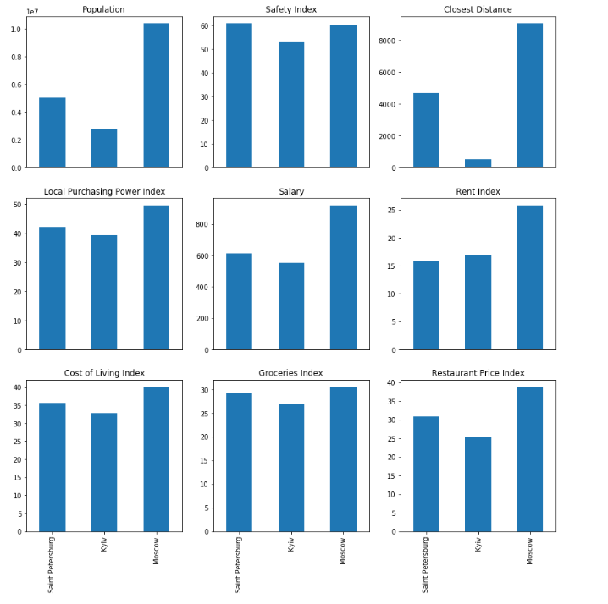
Results – Class 1 Analysis by City
Class 1 cities: Moscow, Saint Petersburg and Kyiv

Slide 8
Discussions and Conclusions
Among the 5 classes, class 1 which are Eastern European cities appear favorable to an investment decision
High population
High distance to the stadium from the existing closest Chinese restaurant
Low salary, cost of living, restaurant price index and other cost consideration
Moderate safety index
From class 1, Moscow is the winner with the same consideration above
This study and analysis can be significantly improved with the data of the number of annual Chinese visitors and estimated football fans in each city.

Slide 9
References
https://worldpopulationreview.com/continents/cities-in-europe/
https://www.numbeo.com/cost-of-living/region_rankings_current.jsp?region=150
https://www.numbeo.com/cost-of-living/region_prices_by_city?itemId=105&region=150
https://www.numbeo.com/property-investment/region_rankings_current.jsp?region=150
https://www.numbeo.com/crime/region_rankings_current.jsp?region=150

